Slide 1

How To Find Memory Leaks
Tamar Twena-Stern

Slide 2
GC Not Running Automatically

Slide 3
Node.js GC Does Not Run Automatically
I had a case where :
Server was running om a machine with 512RAM
GC did not work automatically
The reason :
The old space on heap size start by default with 1.5G
Since server had only 512 RAM and GC is an expensive operation – it was not performed
Solution :
Run your app with a specific size for old space
node –max_old_space_size=400 <my_server_main_script>

Slide 4
Manually Run The Garbage Collector
Enable global GC with :
node –expose_gc
GC is a very expensive operation
Best Practice –
You can run the GC ‘randomly’ with timeout
Make sure it is not running on constant times

Slide 5
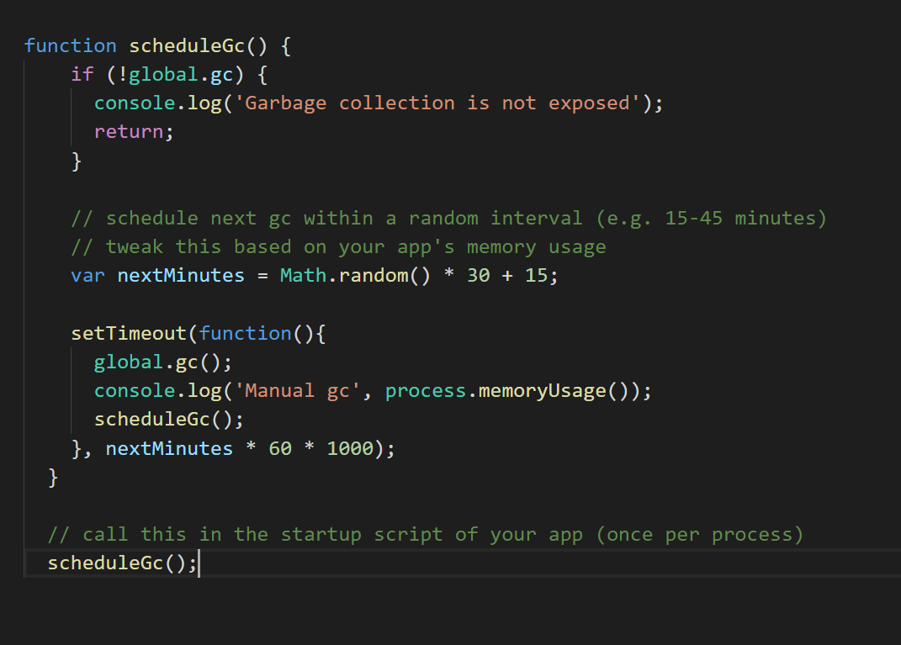
Code Sample – Schedule GC ‘Randomly’

Slide 6
How To Detect Memory Leaks

Slide 7
First Layer Detection – Process.memoryUsage
Returns an object describing the memory usage of the Node process measured in bytes.
You can run this multiple times to see the memory usage
Code :
console.log(process.memoryUsage());
Will generate :
{ rss: 4935680, heapTotal: 1826816, heapUsed: 650472, external: 49879 }

Slide 8
First Layer detection - Memwatch-next module
Recommended module to detect memory leaks
Need to be installed with npm install
npm install memwatch-next
Require the module in your code :
Listen in your code to leak event.

Slide 9
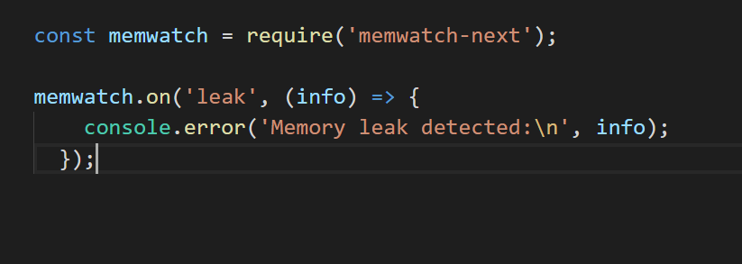
Memwatch-next code sample

Slide 10

The heapDump Module
Create a heap snapshot for later inspection
Add in your entry point of the app the following :
var heapdump = require(‘heapdump’)
Collect a heapdump :
Add the following in your code :

Slide 11
How To Open heapdump Snapshot
Open Chrome Development Tools
Tab name is ‘profile’ or ‘memory’
Load the snapshot created
Comparison Mode – You can perform comperison between 2 snapshots
Retainers tab – shows you the chain of references

Slide 12
Using Node Inspector To Take Snapshots
Possibility to connect node.js to chrome developer tools
Run your app with –inspect flag
Node –inspect <app_main_script>
Connect to your inspect session with the following url :
chrome-devtools://devtools/bundled/inspector.html?experiments=true&v8only=true&ws=<THE_SOCKET_THAT_YOU_GOT>

Slide 13
Node.js –inspect Example
When running with –inspect I got :
Debugger listening on ws://127.0.0.1:9229/da161d57-bee0-4a2b-a71e-42cb39711875
Use this prefix url in browser to connect:
chrome-devtools://devtools/bundled/inspector.html?experiments=true&v8only=true&ws=127.0.0.1:9229/da161d57-bee0-4a2b-a71e-42cb39711875

Slide 14
Take Snapshot with inspect
Memory tab -> take a heap snapshot -> take snapshot
You can take a snapshot while sending requests to your server and see what is going on

Slide 15
Rule Of Thumbs
Only enable memwatch/heapdump on testing.
Writing a heapdump is expensive - consider how many heapdumps to write out before possibly bailing out of the process.
In production : prefer process.memoryUsage()
Memory leaks should gets picked up by your monitoring and alerting tools so humans are told about it.

Slide 16
Beware Of False Positives
Short memory spikes can appear as leaks to memwatch.
If your app suddenly gets busy and uses a big chunk of memory which it takes a while to process, this processing time can span multiple garbage collections and memwatch will report a leak.
When your app is done processing, the memory usage should settle down again.
What you’re really looking for is persistent reporting of memory leaks.
‘Blips’ may actually be ok.

Slide 17
Questions ?

